Slide 1
This is CS50
Hi!
See cs50.harvard.edu for course’s website.
See cs50.harvard.edu/syllabus for syllabus.
See cs50.harvard.edu/faqs for FAQs.
If you have trouble seeing screen on stage, see live.cs50.io/screen on your laptop.
Today’s lecture will be 3pm–4:15pm. Future lectures will be Mondays, 3pm–5pm.
Problem Set 0 due on Sunday 9/8, 11:59pm. See website.
Orientation meetings next week. See website.
CS50 Puzzle Day (a tradition) is this Saturday 9/7, 12pm–3:30pm. Register at cs50.harvard.edu/register. Friends welcome.
Cake (a tradition) will be served in transept after class!

Slide 2
This is CS50

Slide 3
2/3
of CS50 students have never taken CS before

Slide 4
what ultimately matters in this course is not so much where you end up relative to your classmates but where
you end up relative to yourself when you began

Slide 5
input →
→ output

Slide 6
representation

Slide 7

Notes:
https://emojipedia.org/raised-hand-with-fingers-splayed/
Unary

Slide 8
0 1 2 3 4 5 6 7 8 9
Notes:
Decimal

Slide 9
0 1
Notes:
Binary

Slide 10
123

Slide 11
1
123

Slide 12
10
1
123

Slide 13
100
10
1
123

Slide 14
100
10
1
123
100 × 1

Slide 15
100
10
1
123
100 × 1
+

Slide 16
100
10
1
123
100 × 1
+
10 × 2

Slide 17
100
10
1
123
100 × 1
+
10 × 2
+

Slide 18
100
10
1
123
100 × 1
+
10 × 2
+
1 × 3

Slide 19
100
10
1
123
100
+
20
+
3

Slide 20
123

Slide 21
100
10
1
000

Slide 22
100
10
1
001

Slide 23
100
10
1
002

Slide 24
100
10
1
003

Slide 25
100
10
1
004

Slide 26
100
10
1
005

Slide 27
100
10
1
006

Slide 28
100
10
1
007

Slide 29
100
10
1
008

Slide 30
100
10
1
009

Slide 31
100
10
1
010

Slide 32
100
10
1
000

Slide 33
10²
10¹
10⁰
000

Slide 34
2²
2¹
2⁰
000

Slide 35
4
2
1
000

Slide 36
4
2
1
001

Slide 37
4
2
1
010

Slide 38
4
2
1
011

Slide 39
4
2
1
100

Slide 40
4
2
1
101

Slide 41
4
2
1
110

Slide 42
4
2
1
111

Slide 43
bit

Slide 44
💡

Slide 45
bit bit bit bit bit bit bit bit

Slide 46
💡💡💡💡💡💡💡💡

Slide 47
byte

Slide 48
💡💡💡💡💡💡💡💡
Notes:
binary bulbs

Slide 49
A

Slide 50
65

Slide 51
01000001
Notes:
OR show binary bulbs here

Slide 52
65

Slide 53
ASCII

Slide 54
... | A | B | C | D | E | F | G | H | I | ...
... | 65 | 66 | 67 | 68 | 69 | 70 | 71 | 72 | 73 | ...

Slide 55
72 | 73 | 33

Slide 56
H | I
72 | 73 | 33

Slide 57
H | I | !
72 | 73 | 33

Slide 58
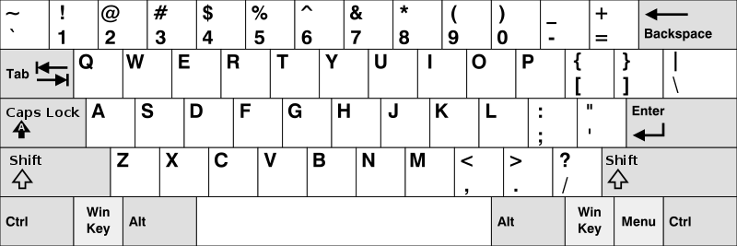
Notes:
https://en.wikipedia.org/wiki/British_and_American_keyboards
But how to represent other symbols?

Slide 59
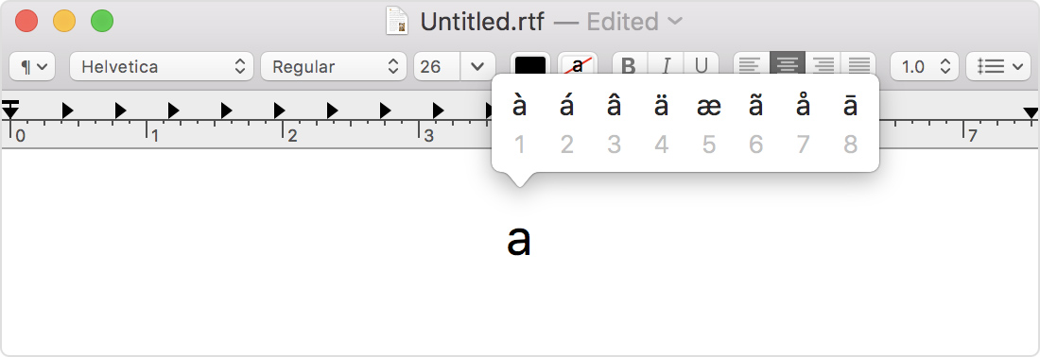
Notes:
https://support.apple.com/en-us/HT201586

Slide 60
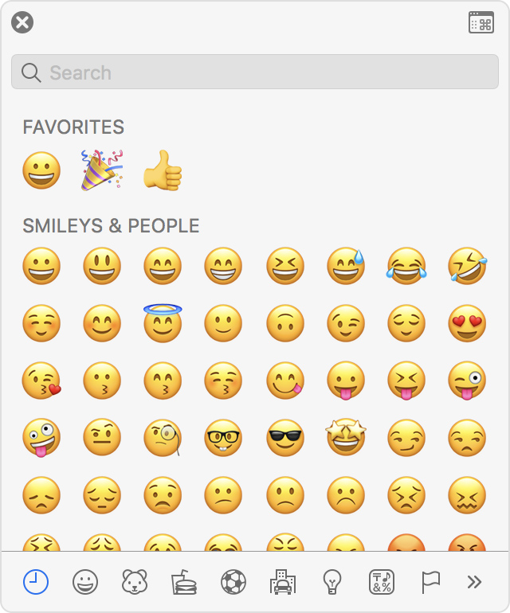
Notes:
https://support.apple.com/en-us/HT201586

Slide 61
Unicode

Slide 62

Notes:
https://emojipedia.org/face-with-tears-of-joy/

Slide 63
128514

Slide 64
11111011000000010

Slide 65
Notes:
Should be #484921ff, but brightened for projectors.

Slide 66
RGB

Slide 68
72 | 73 | 33

Slide 69
72 | 73 | 33

Slide 71
Notes:
Should be #484921ff, but brightened for projectors.

Slide 72
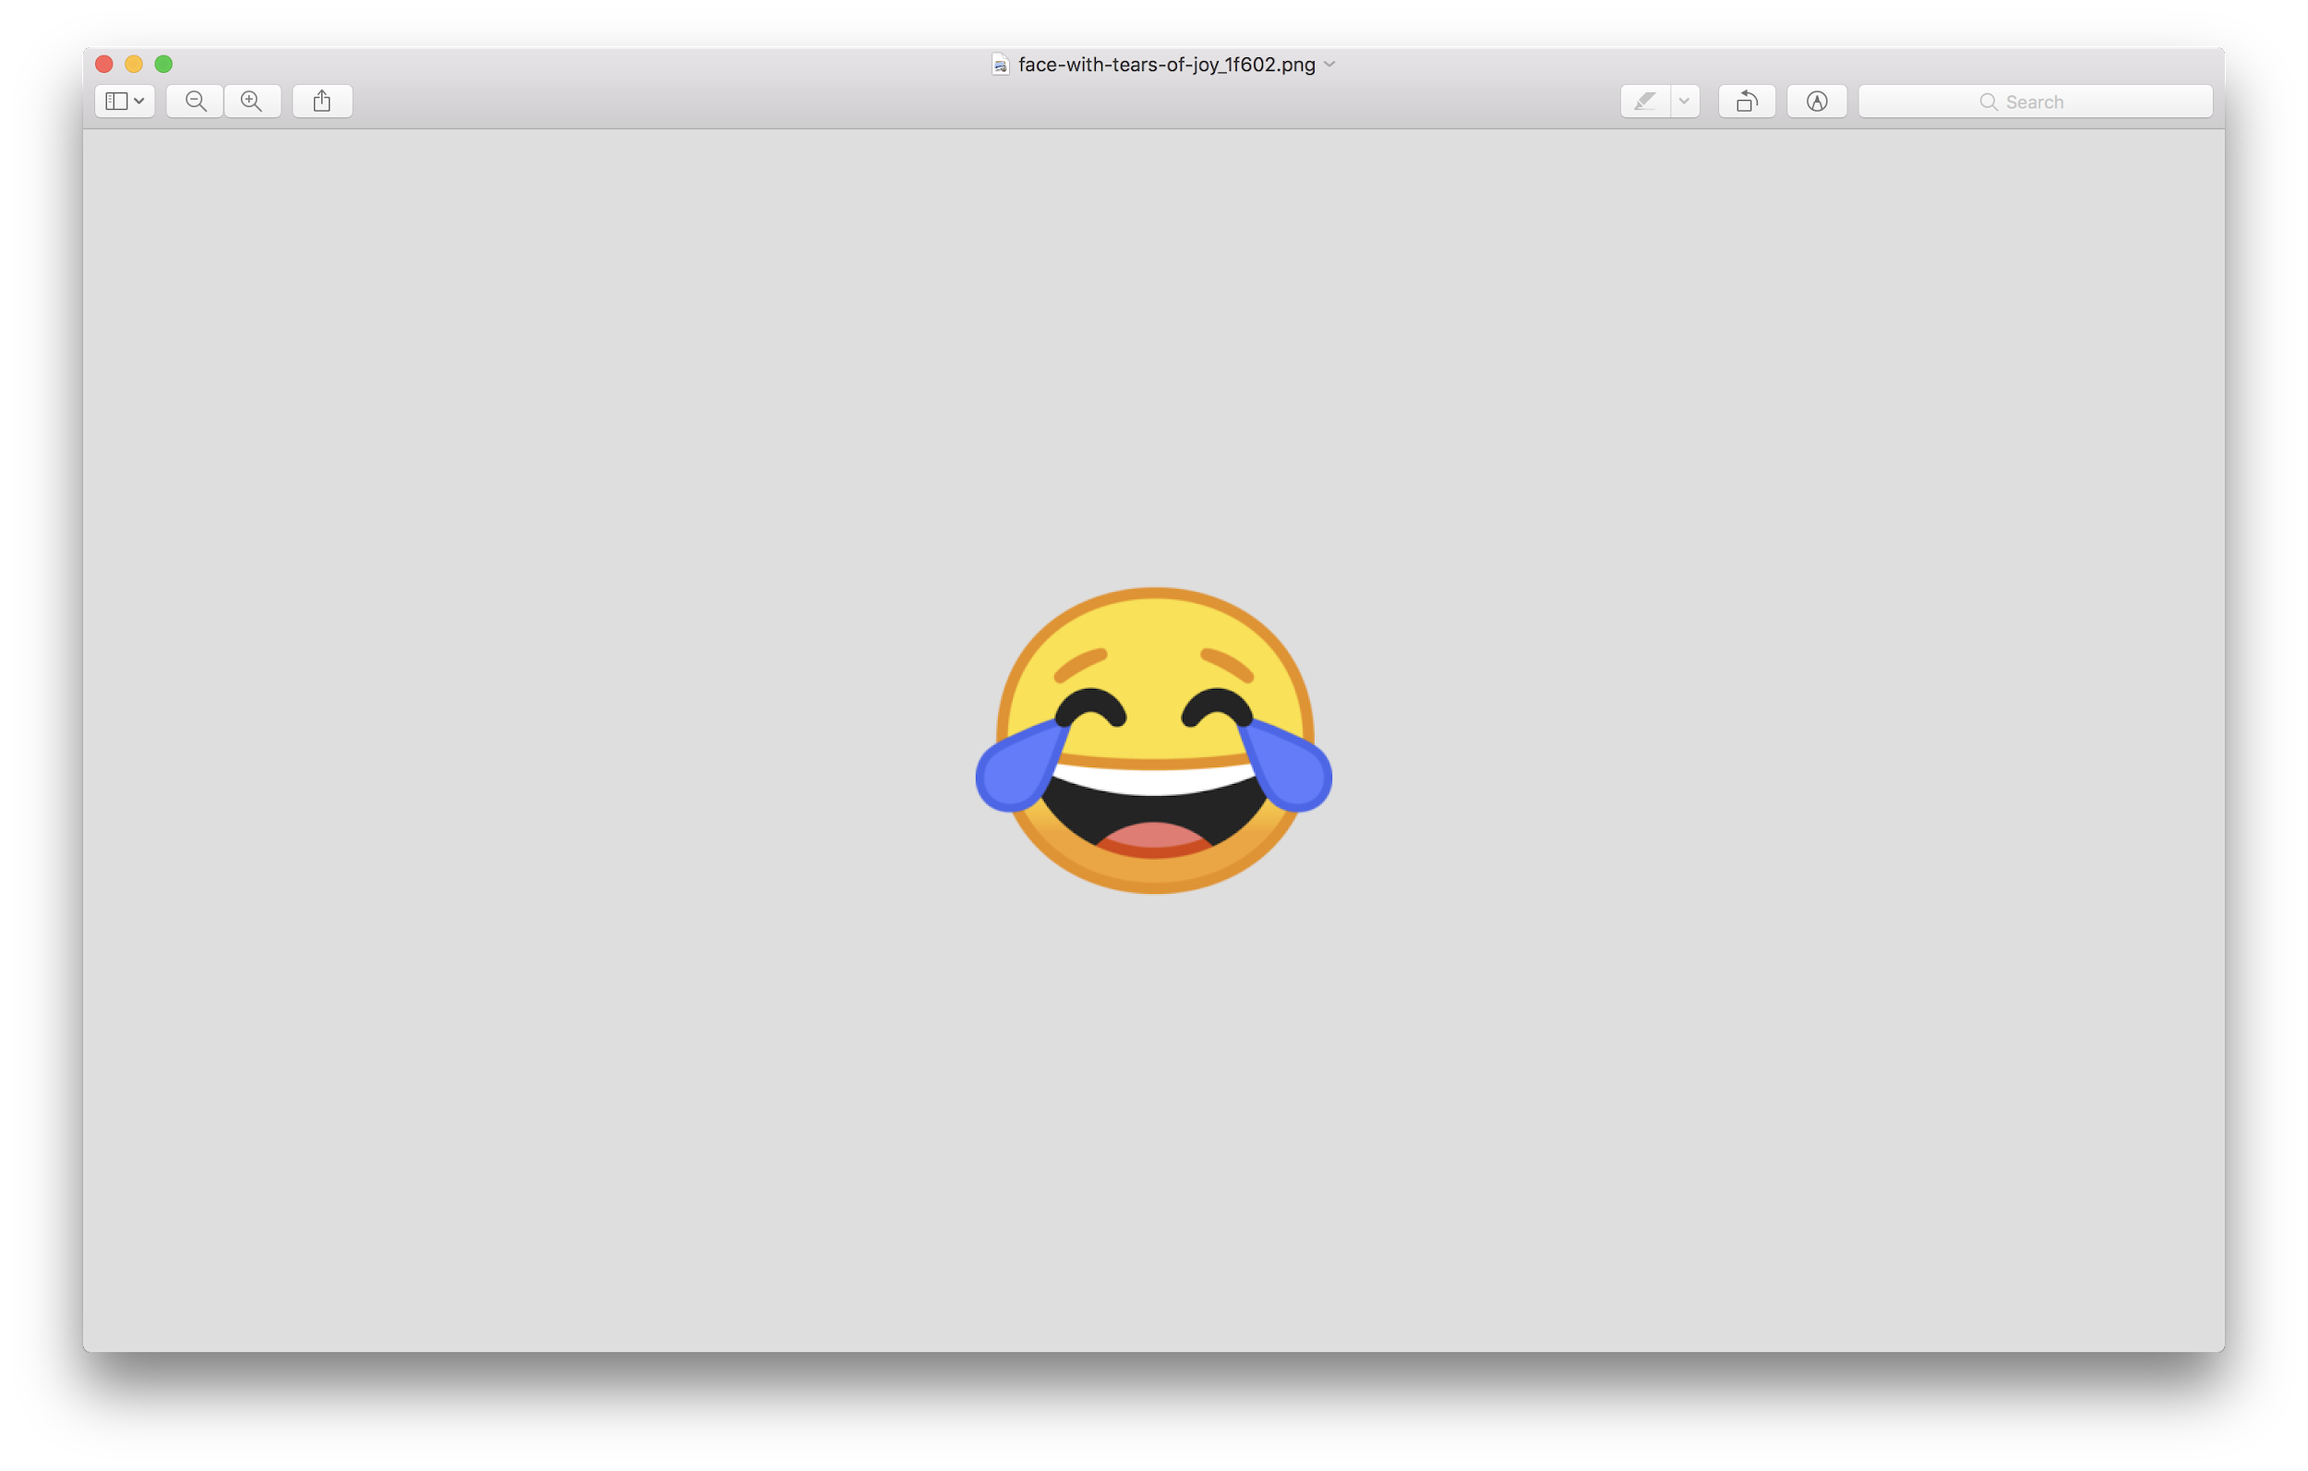

Slide 73
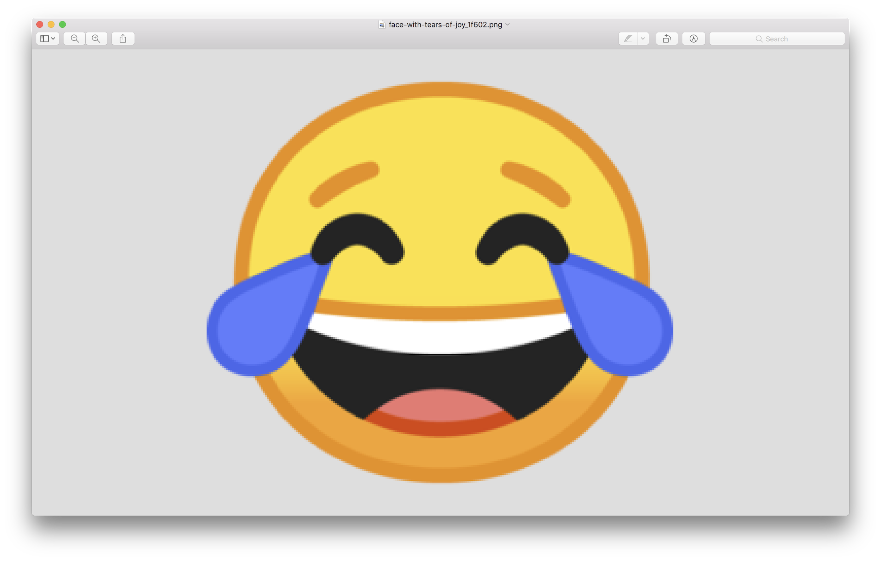

Slide 74
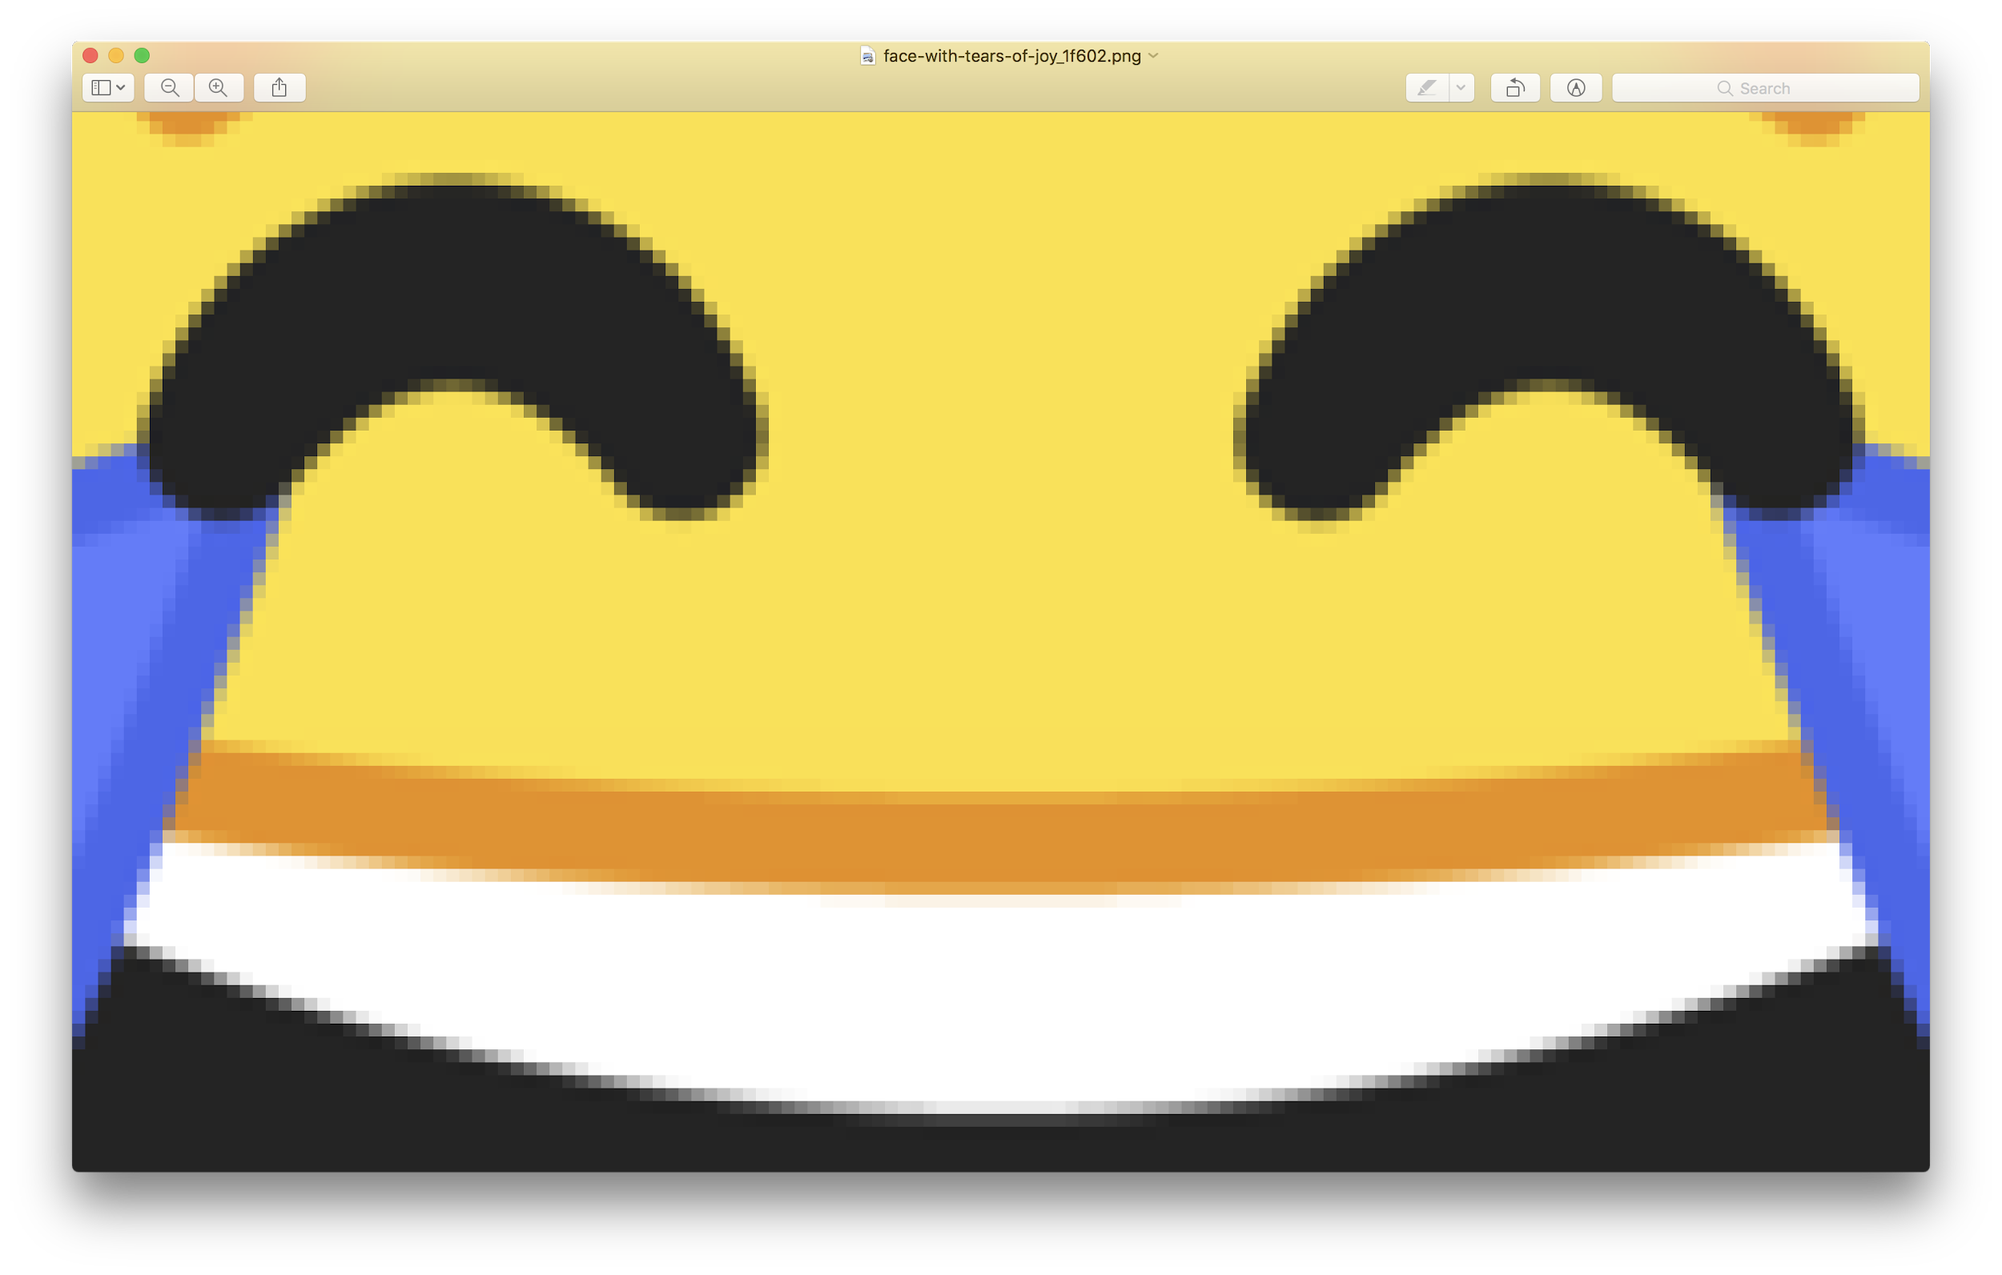

Slide 75
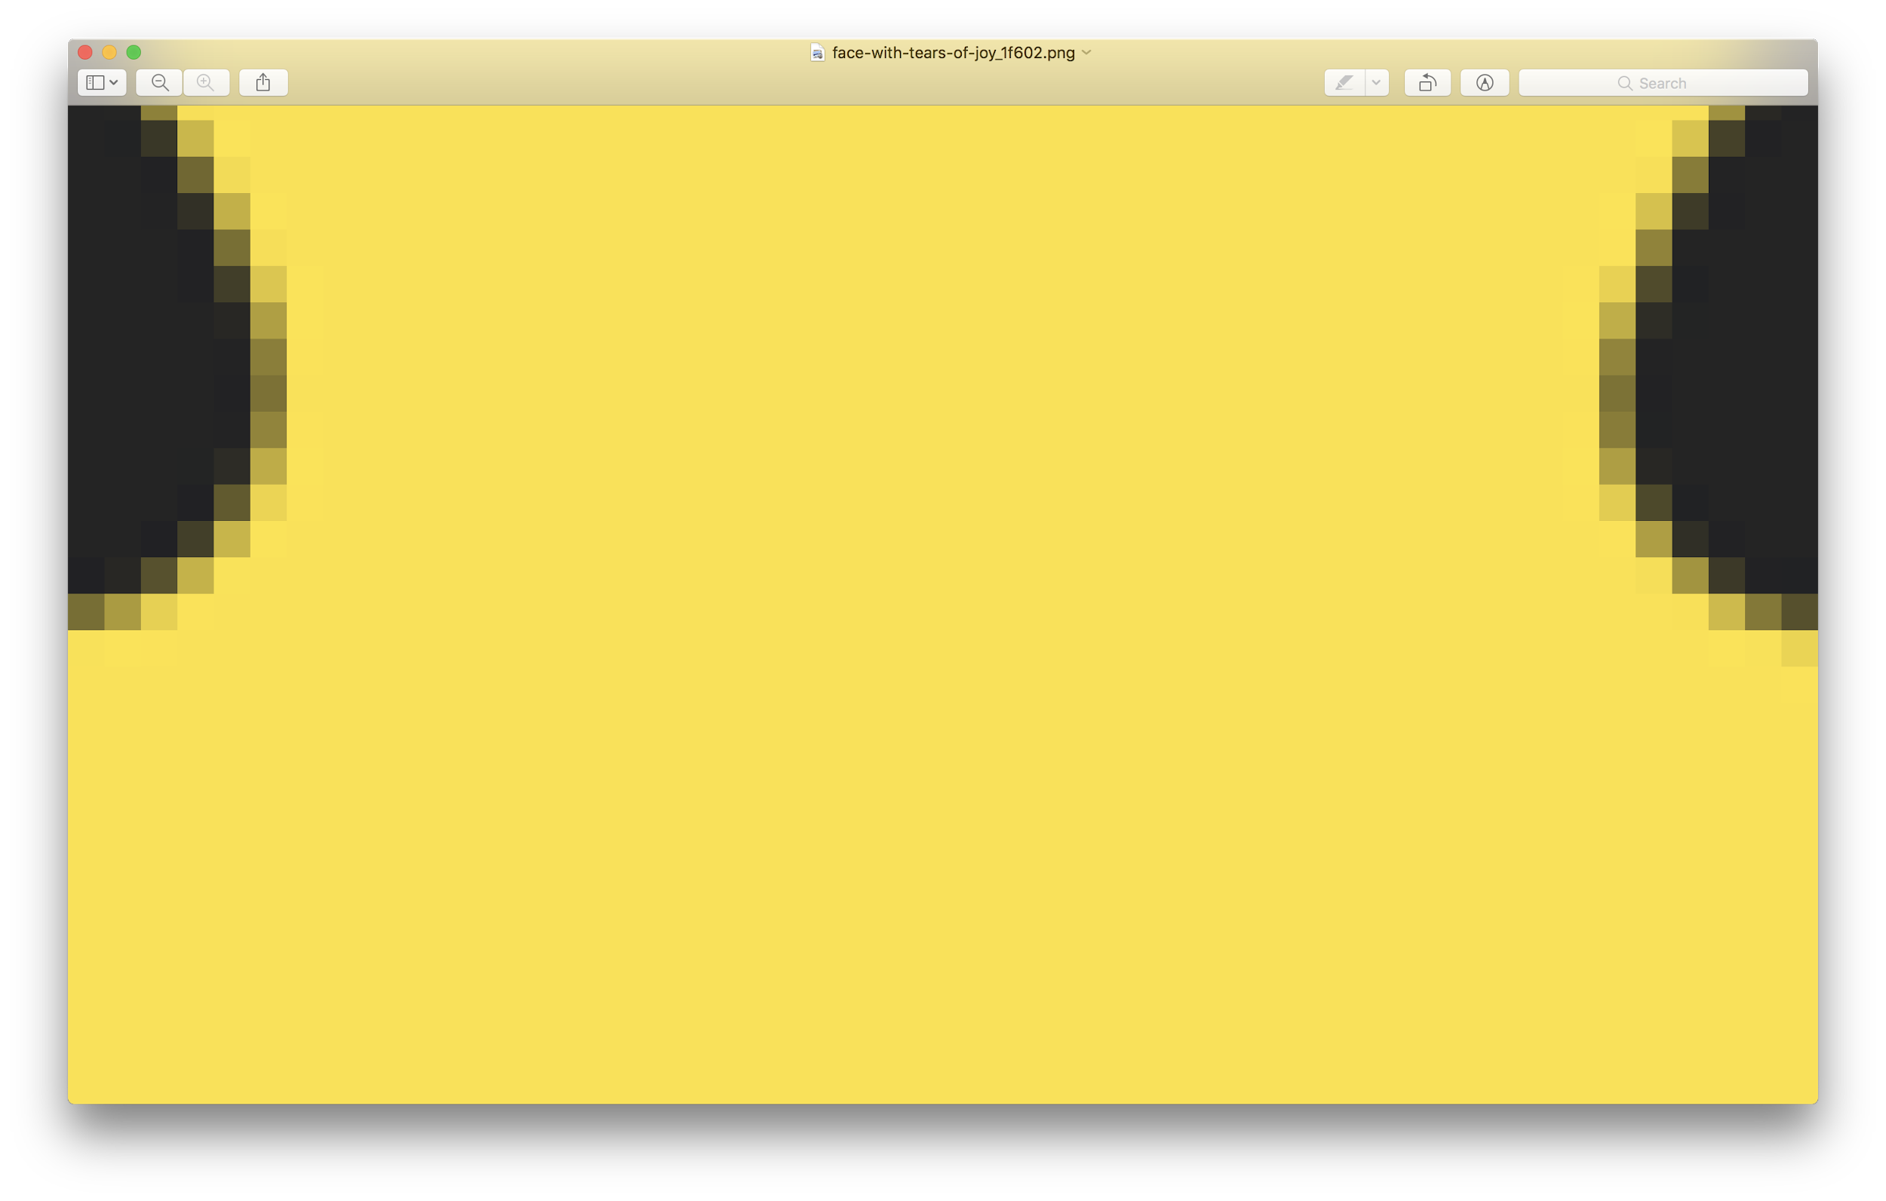
Notes:
The more pixels, the larger the file.

Slide 76
Notes:
https://www.buzzfeed.com/juliegerstein/the-100-greatest-gifs-of-all-time

Slide 77
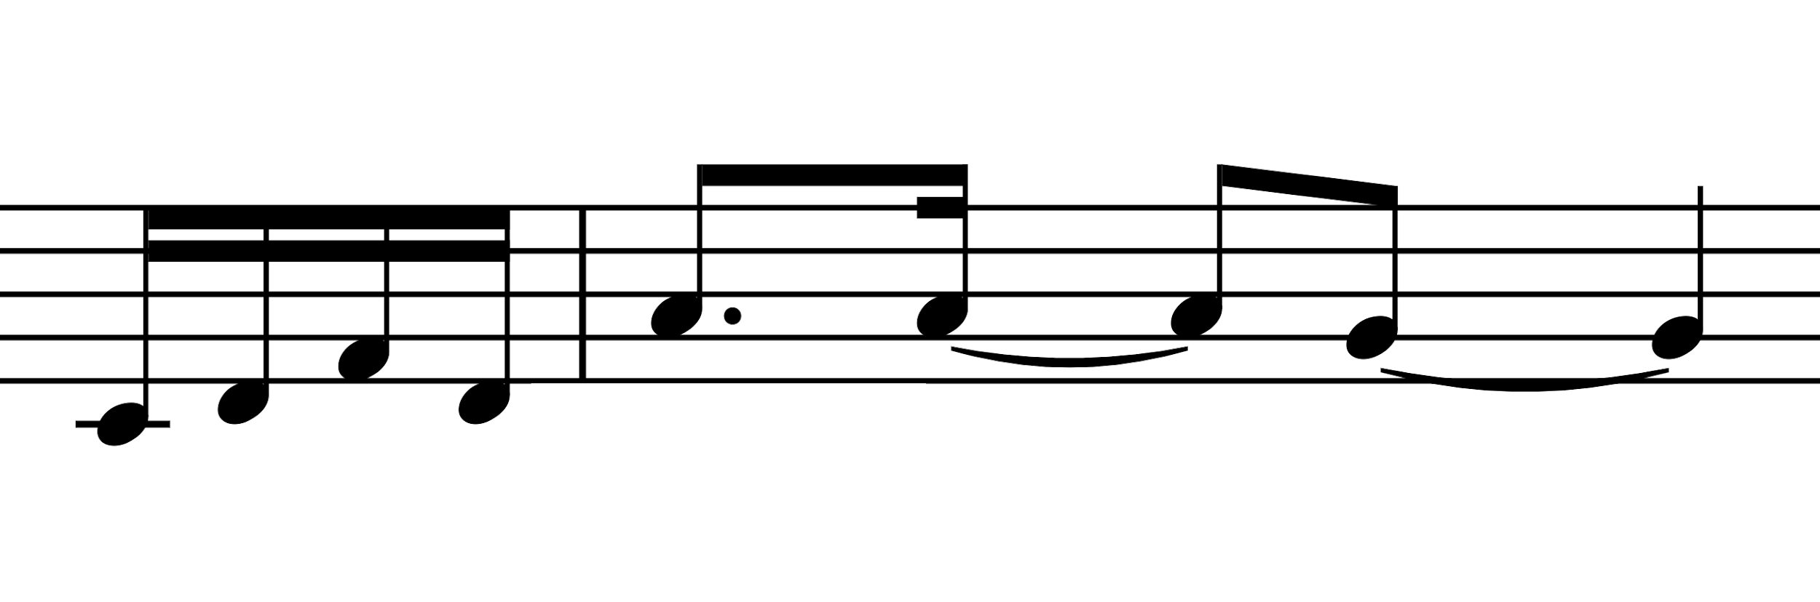
Notes:
note, duration, volume

Slide 78
input →
→ output

Slide 79
algorithms

Slide 80
1024
1023
1022
1021
1020
1019
1018
1017
1016
1015
1014
...

Slide 81
1024
1022
1020
1018
1016
1014
1012
1010
1008
1006
1004
...

Slide 82
1024
512
256
128
64
32
16
8
4
2
1

Slide 83
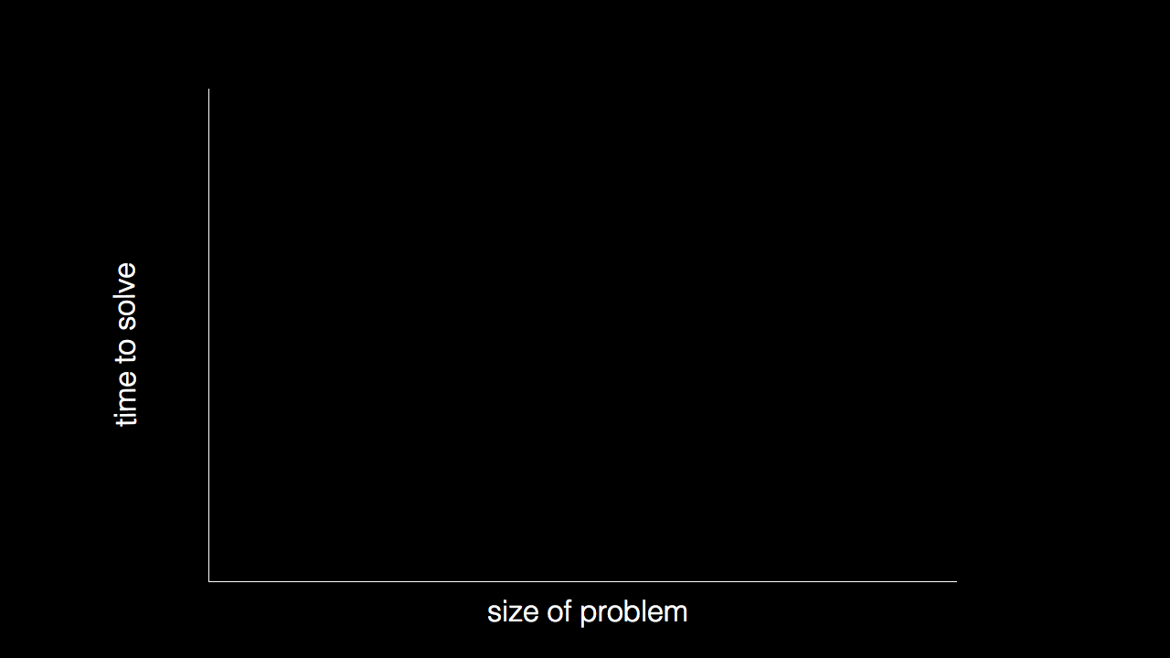

Slide 84
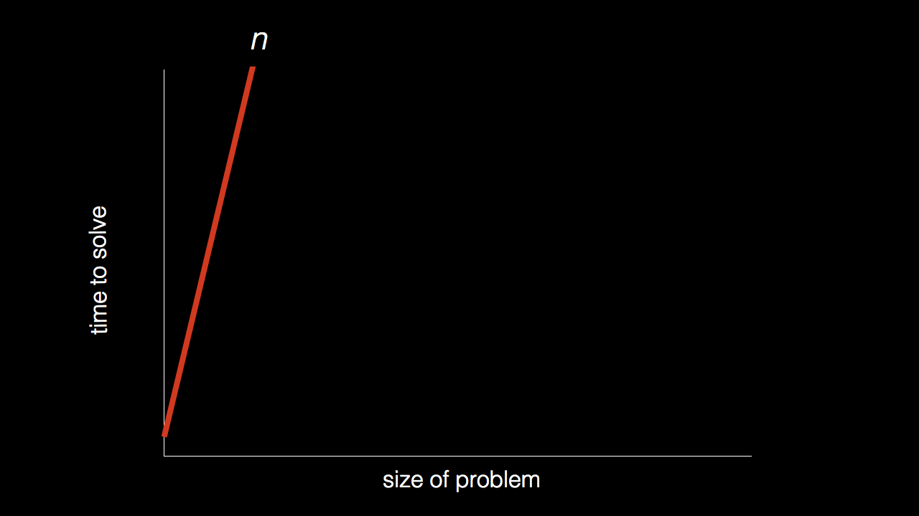

Slide 85
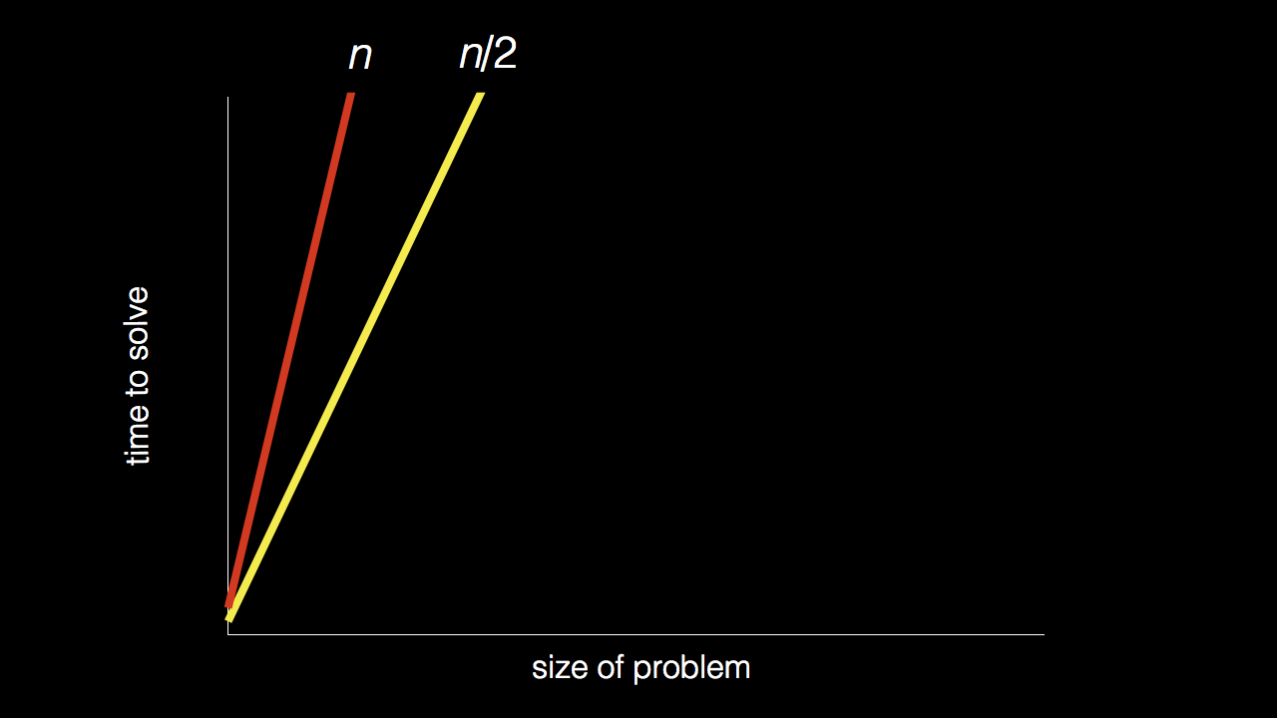

Slide 90
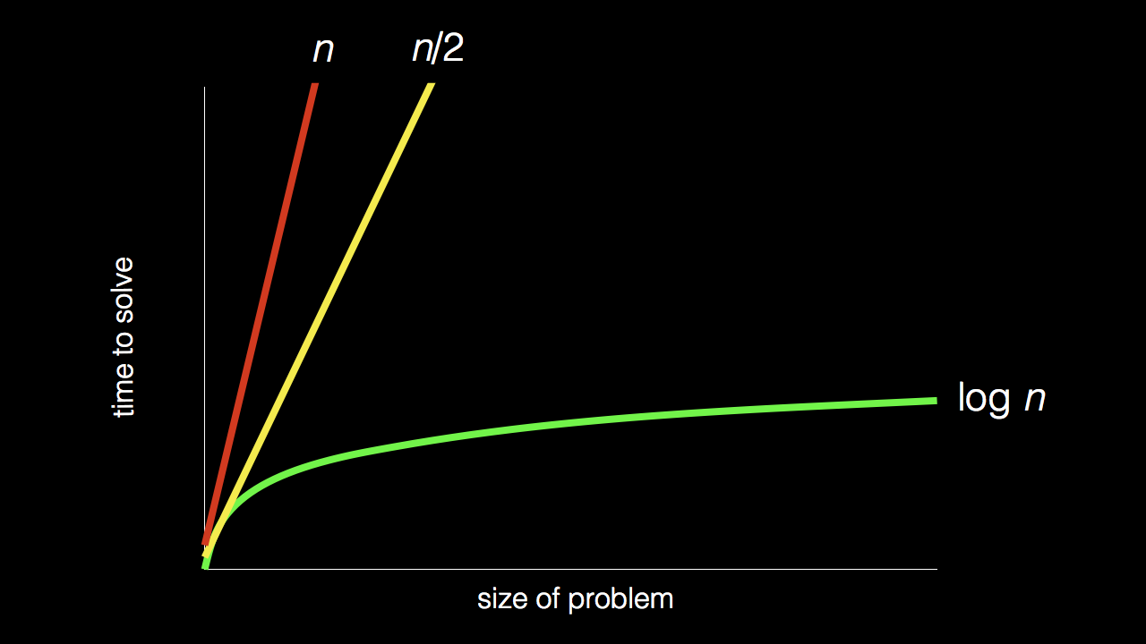

Slide 91
pseudocode

Slide 92
1 Pick up phone book
2 Open to middle of phone book
3 Look at page
4 If Smith is on page
5 Call Mike
6 Else if Smith is earlier in book
7 Open to middle of left half of book
8 Go back to line 3
9 Else if Smith is later in book
10 Open to middle of right half of book
11 Go back to line 3
12 Else
13 Quit

Slide 93
1 Pick up phone book
2 Open to middle of phone book
3 Look at page
4 If Smith is on page
5 Call Mike
6 Else if Smith is earlier in book
7 Open to middle of left half of book
8 Go back to line 3
9 Else if Smith is later in book
10 Open to middle of right half of book
11 Go back to line 3
12 Else
13 Quit

Slide 94
1 Pick up phone book
2 Open to middle of phone book
3 Look at page
4 If Smith is on page
5 Call Mike
6 Else if Smith is earlier in book
7 Open to middle of left half of book
8 Go back to line 3
9 Else if Smith is later in book
10 Open to middle of right half of book
11 Go back to line 3
12 Else
13 Quit

Slide 95
1 Pick up phone book
2 Open to middle of phone book
3 Look at page
4 If Smith is on page
5 Call Mike
6 Else if Smith is earlier in book
7 Open to middle of left half of book
8 Go back to line 3
9 Else if Smith is later in book
10 Open to middle of right half of book
11 Go back to line 3
12 Else
13 Quit

Slide 96
1 Pick up phone book
2 Open to middle of phone book
3 Look at page
4 If Smith is on page
5 Call Mike
6 Else if Smith is earlier in book
7 Open to middle of left half of book
8 Go back to line 3
9 Else if Smith is later in book
10 Open to middle of right half of book
11 Go back to line 3
12 Else
13 Quit

Slide 97
functions
conditions
Boolean expressions
loops

Slide 98
functions
conditions
Boolean expressions
loops
variables
threads
events
...

Slide 99
#include <stdio.h>
int main(void) {
printf("hello, world\n");
}

Slide 100
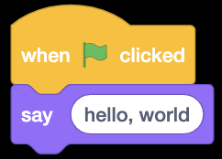
Notes:
https://scratch.mit.edu/projects/326949981/editor/

Slide 101
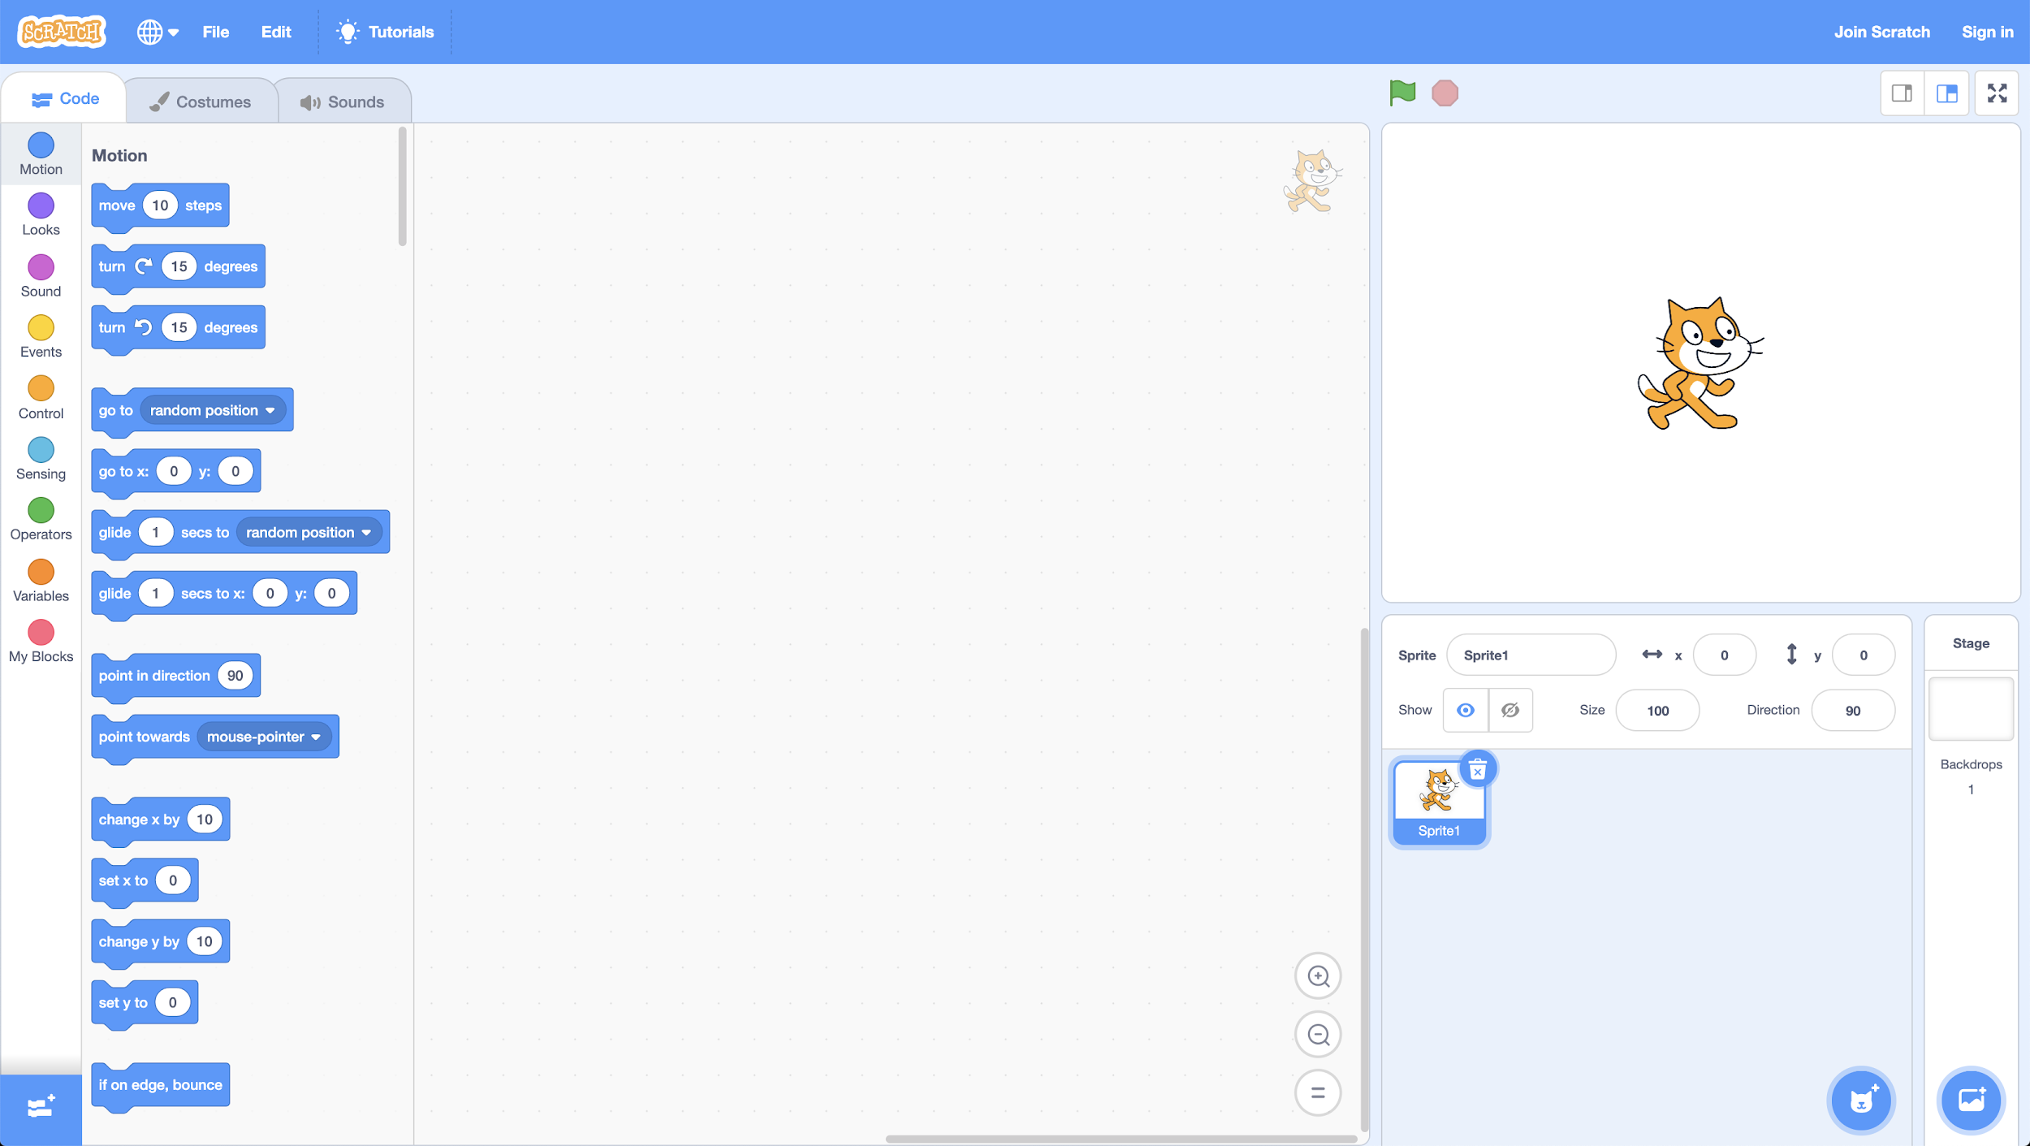

Slide 106
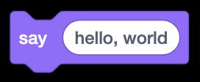

Slide 107
algorithms
input →
→ output

Slide 108

algorithms
→
→
→ output

Slide 109

→
→
→ output

Slide 110
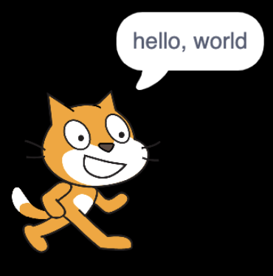
→
→

Slide 111
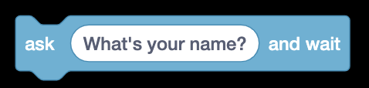

Slide 112
algorithms
input →
→ output

Slide 113
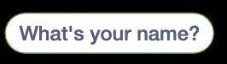
algorithms
→
→
→ output

Slide 114
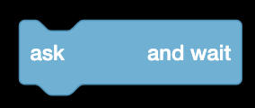
→
→
→ output

Slide 115
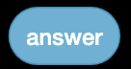
→
→

Slide 116
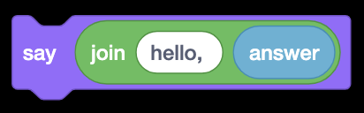

Slide 117
algorithms
input →
→ output

Slide 118

algorithms
→
→
→ output

Slide 119

→
→
→ output

Slide 120
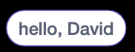
→
→

Slide 121
→

Slide 122
→

Slide 123
→
→

Slide 124
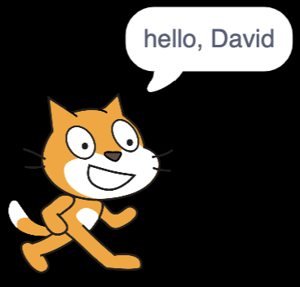
→
→
→

Slide 125


Slide 126
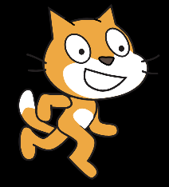

Slide 127
This is CS50

Slide 128
